Slide 1
Design and Analysis of Algorithms
Lecture 4
Instructor: Mehak Riaz
Email: Mehak.riaz@kiet.edu.pk

Slide 2
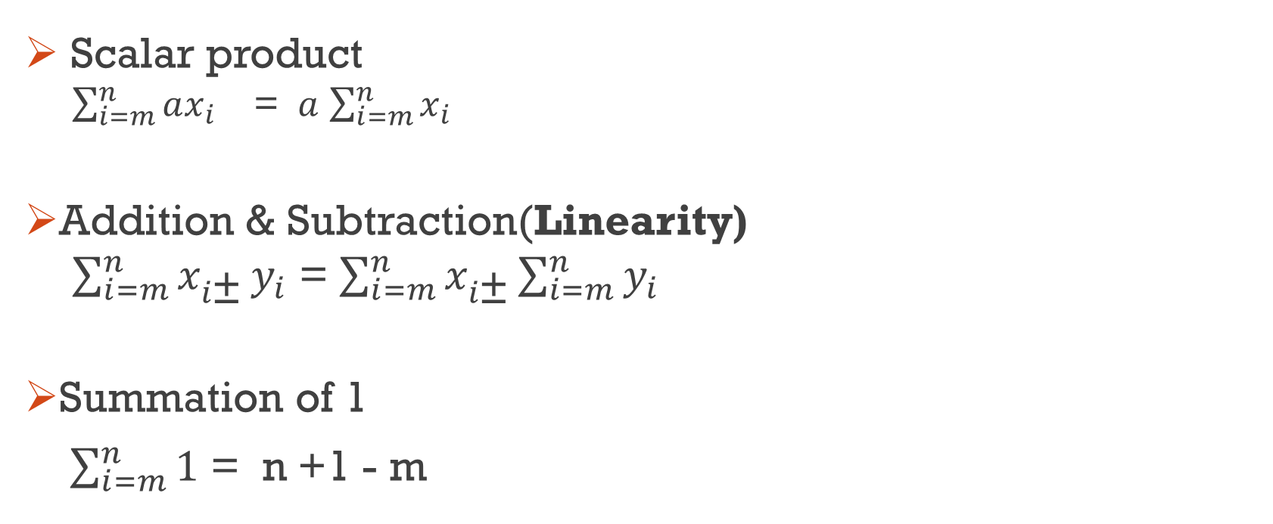
Summation Properties
Scalar product
$\sum_{i=m}^{n}{ax_{i}}$ = $a$ $\sum_{i=m}^{n}{x_{i}}$
Addition & Subtraction(Linearity)
$\sum_{i=m}^{n}{x_{i\text{±}}}y_{i}$ = $\sum_{i=m}^{n}{x_{i\text{±}}}\sum_{i=m}^{n}{y_{i}}$
Summation of 1
$\sum_{i=m}^{n}{1}$ = n +1 - m

Slide 3

Example for scalar
X={10,3,5,7,2,9,4}
$\sum_{i=2}^{5}{2x_{i}}$
(2.x2)+(2.x3)+(2.x4)+(2.x5)
(2.5)+(2.7)+(2.2)+(2*9)
10+14+4+18
46
2(5+7+2+9)
2(23)
46

Slide 4
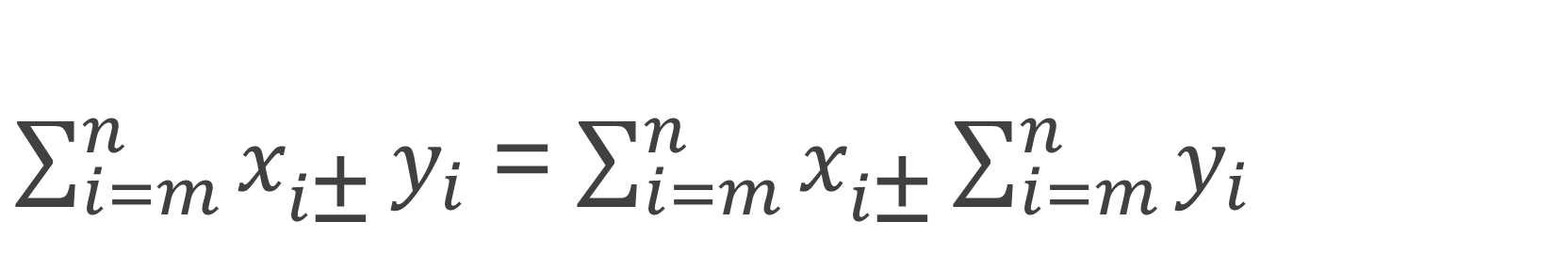
$\sum_{i=m}^{n}{x_{i\text{±}}}y_{i}$ = $\sum_{i=m}^{n}{x_{i\text{±}}}\sum_{i=m}^{n}{y_{i}}$
i=2→5
Take indexing from 0 , i=0
X={2,3,4,7,6,5}
Y={1,7,4,3,6,8}
(4+7+6+5) + (4+3+6+8) =43
((4+4)+(7+3)+(6+6)+(5+8) =43

Slide 5
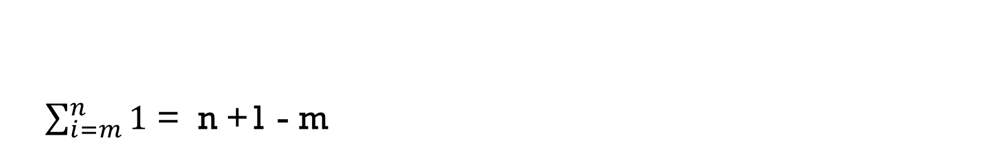
$\sum_{i=m}^{n}{1}$ = n +1 - m
i=1 -→6
1+1+1+1+1+1=6
6+1-1=6

Slide 6

Summation Properties
Summation of AP
$\sum_{i=m}^{n}{i}$ = $\frac{n(n+1)}{2}$
Summation of Square
$\sum_{i=m}^{n}{i^{2}}$ = $\frac{n(n+1)(2n+1}{6}$

Slide 7
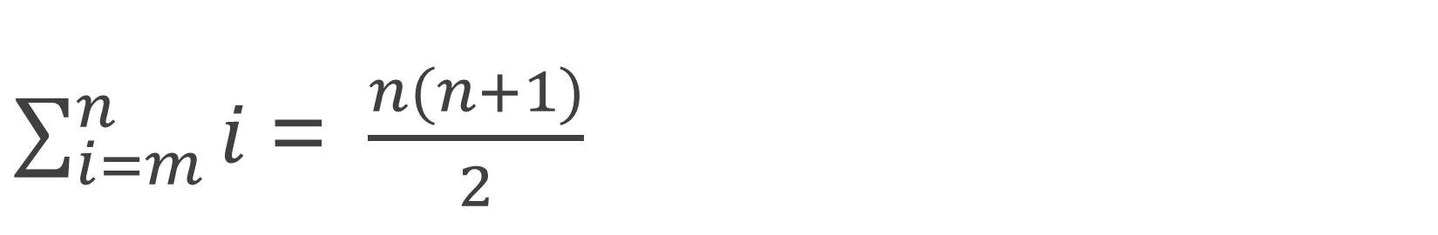
$\sum_{i=m}^{n}{i}$ = $\frac{n(n+1)}{2}$
i=1→ 6
1+2+3+4+5+6 =21
6(6+1)/2
6(7)/2
42/2 =21

Slide 8
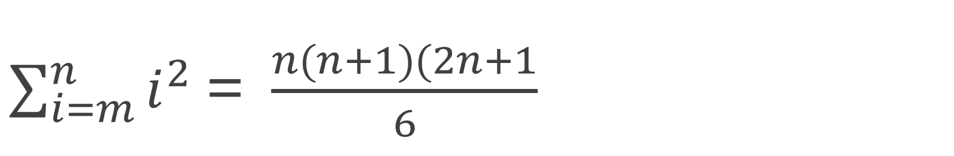
$\sum_{i=m}^{n}{i^{2}}$ = $\frac{n(n+1)(2n+1}{6}$
i=1→4
(1^2)+(2^2)+(3^2)+(4^2) = 1+4+9+16=30
4(4+1)(2.4+1)/6
4(5)(9)/6
180/6
=30

Slide 9
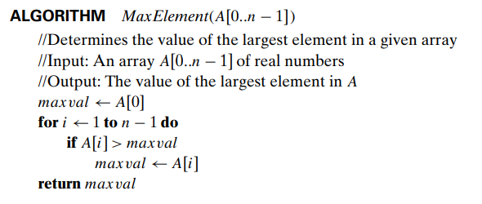

Examples
$$\sum_{i=1}^{n−1}{1}$$
(n-1)+1-1=n-1
O(n)

Slide 10

example
int array_sum(int[] a, int n) { int i; int sum = 0; for (i = 0; i < n; i++) { sum = sum + a[i] } return sum; }
Upper limit = n
Lower limit = m
i=m
$\sum_{i=0}^{n}{1}$ =n+1-m
N+1-0=n+1→ O(n)

Slide 11
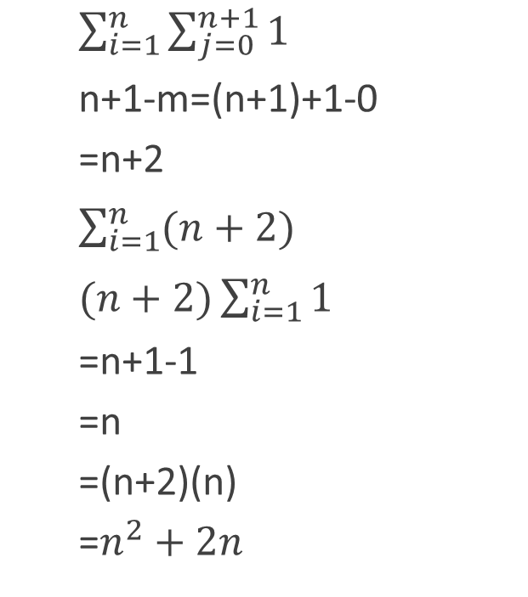
example
for(i=1; i<n; i++)
for(j=0; j<n+1; j++)
{
print()
}
$\sum_{i=1}^{n}{\sum_{j=0}^{n+1}{1}}$
n+1-m=(n+1)+1-0
=n+2
$\sum_{i=1}^{n}{(n+2)}$
$(n+2)\sum_{i=1}^{n}{1}$
=n+1-1
=n
=(n+2)(n)
=$n^{2}+2n$

Slide 12
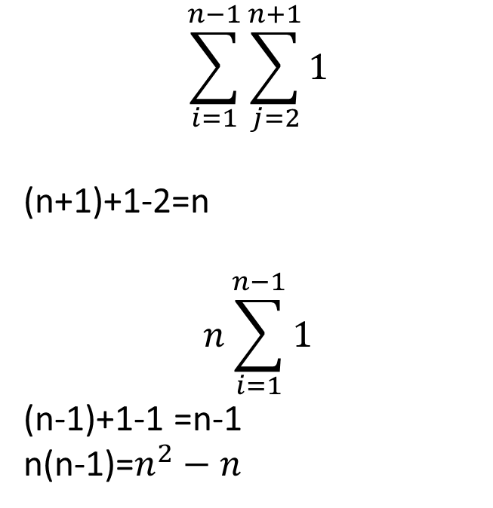
Example
for(i=1; i<n-1; i++)
for(j=2; j<n+1; j++)
{
print()
}
$$\sum_{i=1}^{n−1}{\sum_{j=2}^{n+1}{1}}$$
(n+1)+1-2=n
$$n\sum_{i=1}^{n−1}{1}$$
(n-1)+1-1 =n-1
n(n-1)=$n^{2}−n$

Slide 13
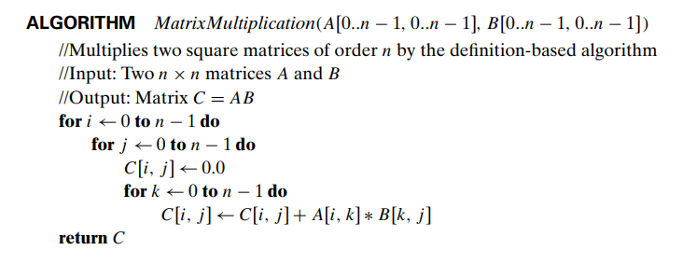

Examples
$$\sum_{i=0}^{n−1}{\sum_{j=0}^{n−1}{\sum_{k=0}^{n−1}{1}}}$$

Slide 14
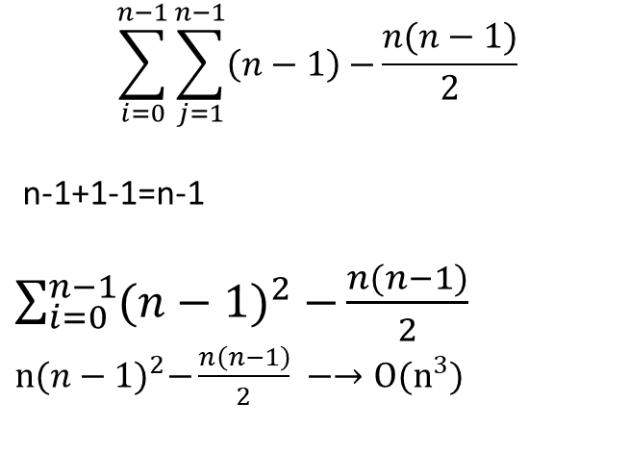
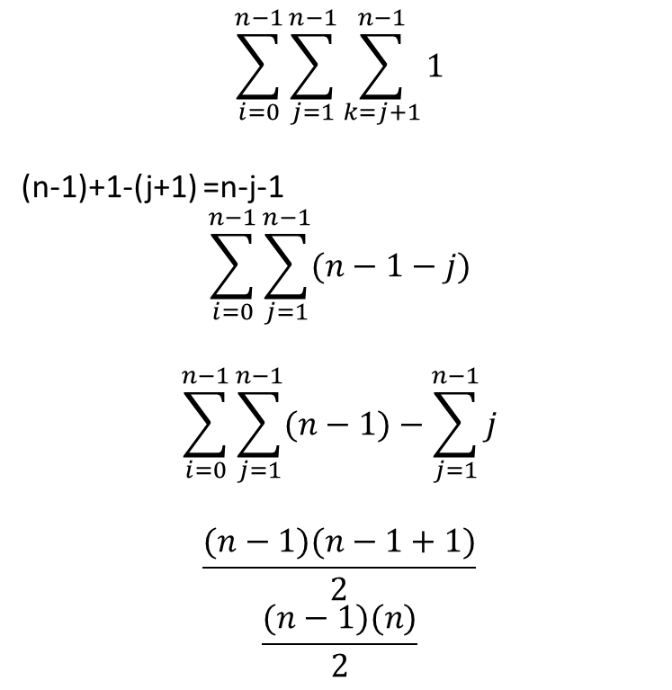
Example
For i ← 0 to n-1
For j ← 1 to n-1
For k ← j+1 to n-1
$$\sum_{i=0}^{n−1}{\sum_{j=1}^{n−1}{\sum_{k=j+1}^{n−1}{1}}}$$
(n-1)+1-(j+1) =n-j-1
$$\sum_{i=0}^{n−1}{\sum_{j=1}^{n−1}{(n−1−j)}}$$
$$\sum_{i=0}^{n−1}{\sum_{j=1}^{n−1}{(n−1)}}−\sum_{j=1}^{n−1}{j}$$
$$\frac{(n−1)(n−1+1)}{2}$$
$$\frac{(n−1)(n)}{2}$$
$$\sum_{i=0}^{n−1}{\sum_{j=1}^{n−1}{\left(n−1\right)−}\frac{n(n−1)}{2}}$$
n-1+1-1=n-1
$\sum_{i=0}^{n−1}{({n−1)}^{2}−}\frac{n(n−1)}{2}$
$n{(n−1)}^{2}−\frac{n\left(n−1\right)}{2} −→O(n^{3})$

